Slide 1

Fast Maximum Margin Matrix Factorization (MMMF) For Collaborative Prediction
exp. results
old proposal
conclusion
new proposal
significance
implementation
Submitted By: Satripleen Kaur
Course: ECE-602 Introduction to Optimization
Term: Jan-2020
Date:24/April/2020

Slide 2
Fast Maximum Margin Matrix Factorization (MMMF) For Collaborative Prediction
Matrix Factorization: Matrix Factorization is the algorithm set of collaborating filtering generally used for recommendation systems.
Collaborative Prediction: ‘Collaborative Prediction’ refers to the task of offering recommendations & results based on user’s own earlier preferences & other relevant user’s preferences.
The above concept is used to find out the predicted ratings for the given item on the basis of previous data.
Examples: It is used in movie rating, Netflix recommendations and e-commerce shopping platforms.
exp. results
old proposal
significance
conclusion
new proposal
implementation

Slide 3
Maximum Margin Matrix Factorization (MMMF) was recently suggested (Srebro et al., 2005) as a convex, infinite dimensional alternative to low-rank approximations and standard factor models.
Gradient-decent optimization method for MMMF and demonstrate it on large collaborative prediction problems.
The drawback of gradient-decent method to find out the optimal solution is comparatively slow in comparison to conjugate-gradient method.
exp. results
old proposal
conclusion
new proposal
significance
implementation

Slide 4

The main objective is to decompose Y matrix in lower rank matrix X with the fact that the knowledge of Y is preserved in X.
$\min{{|\left|X\right||}_{∑}+C\sum{h(Y_{ij}X_{ij})}}$
Consider adding to the loss a penalty term which is the sum of squares of entries in U and V , i.e. ${|\left|U\right||}_{Fro}^{2}$ + ${|\left|V\right||}_{Fro}^{2}$ ,which makes it into regularized linear prediction problem.
According to Lemma 1, X matrix can be written as:
min $_{X=UV}^{U,V}{(|\left|U\right||}_{Fro}$ ${|\left|V\right||}_{Fro})$
min $_{X=UV}^{U,V}{ \frac{1}{2}(|\left|U\right||}_{Fro}^{2}\text{ + }{|\left|V\right||}_{Fro}^{2})$
The sum of singular values of X i.e tr λ where X = UλV is singular value decomposition of X.
exp. results
old proposal
conclusion
implementation
new proposal
significance

Slide 5
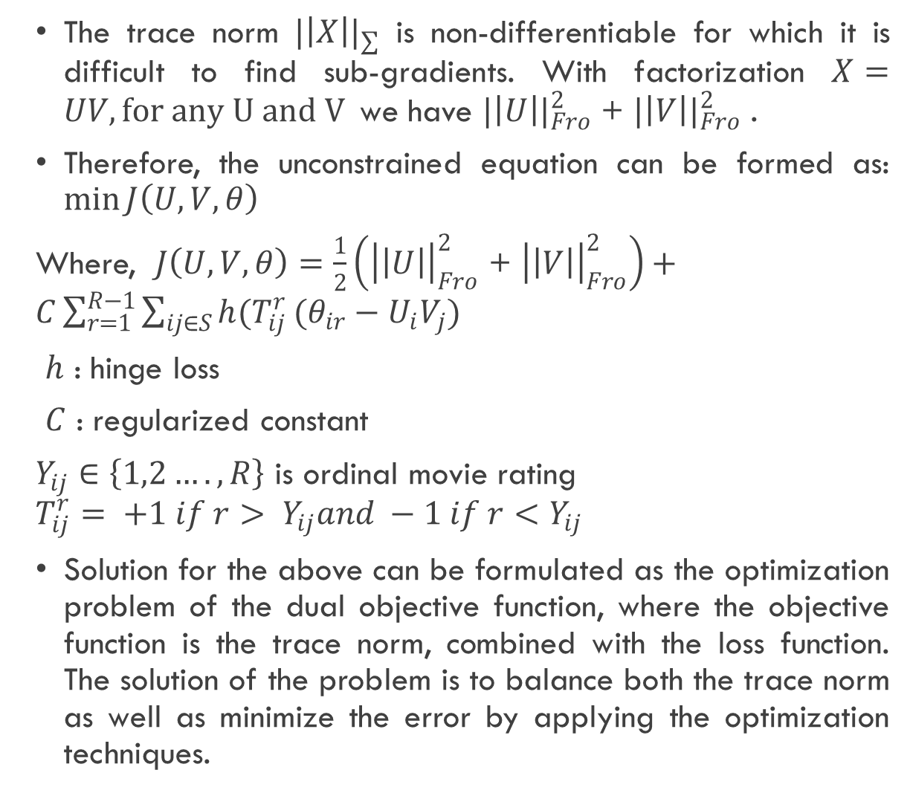
The trace norm ${|\left|X\right||}_{∑}$ is non-differentiable for which it is difficult to find sub-gradients. With factorization $X=UV, for any U and V$we have ${|\left|U\right||}_{Fro}^{2}$ + ${|\left|V\right||}_{Fro}^{2}$ .
Therefore, the unconstrained equation can be formed as: $\min{J\left(U,V,θ\right)}$
Where, $J\left(U,V,θ\right)=\frac{1}{2}\left({\left|\left|U\right|\right|}_{Fro}^{2}\text{ + }{\left|\left|V\right|\right|}_{Fro}^{2}\right)+C\sum_{r=1}^{R−1}{\sum_{ij∈S}{h(T_{ij}^{r}}(θ_{ir}−U_{i}V_{j})}$
$h$ : hinge loss
$C$ : regularized constant
$Y_{ij}∈\left\{1,2….,R\right\}$ is ordinal movie rating
$$T_{ij}^{r}= +1 if r> Y_{ij}and −1 if r<Y_{ij}$$
Solution for the above can be formulated as the optimization problem of the dual objective function, where the objective function is the trace norm, combined with the loss function. The solution of the problem is to balance both the trace norm as well as minimize the error by applying the optimization techniques.
exp. results
old proposal
conclusion
implementation
new proposal
significance

Slide 6
Implementation of Optimized solution (Gradient Conjugate)
Initialization:(To start with the initial guess (x₀))
exp. results
old proposal
conclusion
new proposal
significance
implementation
Calculate the sensitivity co-efficient
Compute the direction of decent (which is orthogonal to previous direction) & search the step size
Next Estimation
no
If f(x^{k+1}) < tol
yes
Stop

Slide 7
Experimental Results
To find out the best optimization solution using Conjugate Gradient Method we have used is the theory of weak generalised result and strong generalized result by using the different C (regularized constant) and found out the Normalised Mean absolute Error (NMAE).
“Weak generalization” is a single stage process which involves the learner filling-in missing entries of a rating matrix. “Strong generalization” is a two-stage process where the learner trains a model on one set of users and then is asked to make predictions on a new set of users. The learner is given sample ratings on the new set of users, but may not utilize those ratings until after the initial model is constructed
old proposal
conclusion
exp. results
significance
new proposal
implementation

Slide 8
The observations of Weak Generalization With different C values:
Weak Generalization: C = 0.030000 trained in 208.269904s. Training NMAE = 0.405567, Validation NMAE = 0.475893
Weak Generalization: C = 0.100000 trained in 242.036501s. Training NMAE = 0.069915, Validation NMAE = 0.453571
Weak Generalization: C = 1.000000 trained in 280.078710s. Training NMAE = 0.000000, Validation NMAE = 0.497321
Weak Generalization: C = 3.000000 trained in 366.146930s. Training NMAE = 0.000050, Validation NMAE = 0.472321
Best validation parameter C = 0.100000
Best Weak Test NMAE = 0.450893
The observation of Strong generalized
Strong Train NMAE = 0.143175, Test NMAE = 0.0550412
old proposal
conclusion
exp. results
significance
new proposal
implementation

Slide 9
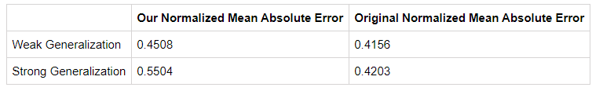
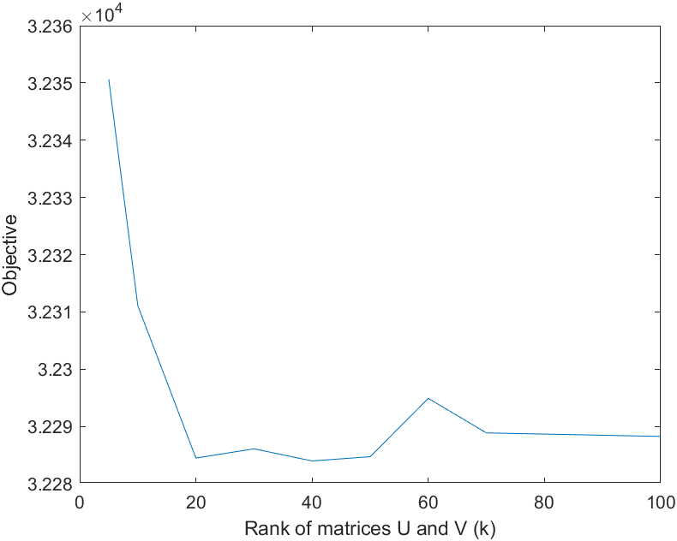
From the observations we can see that the Normalized Absolute Loss which we have got both for Weak and Strong Generalization are comparable with what the author has proposed.
old proposal
conclusion
exp. results
significance
new proposal
implementation
From the graph we have achieved that the rank of U and V is not required to be large as we can see that for k>30 we get almost the same result.

Slide 10
The results which we have got are reasonably close in terms of the NMAE to suggest that the optimization algorithm behaves in a predictable way.
It has been shown that it is possible to “scale-up” MMMF to large problems by demonstrating the technique on the 1M MovieLens dataset as stated in paper and on the 100k MovieLens dataset as used in this project.
The underlying assumption in a collaborative prediction situation is that the prediction tasks (Columns of Y) are related, for that the same feature can be used for complete data.
exp. results
old proposal
conclusion
new proposal
significance
implementation

Slide 11
1) Rennie, J., Srebro, N., Fast maximum margin matrix factorization for collaborative prediction, in Proceedings of the International Conference of Machine Learning (2005)
2) Srebro, N., Schraibman, A. Rank, trace-norm and max-norm. Proceedings of the 18th Annual Conference on Learning Theory.(2005).
3) F. Maxwell Harper and Joseph A. Konstan. 2015. The MovieLens Datasets: History and Context. ACM Transactions on Interactive Intelligent Systems (TiiS) 5, 4, Article 19 (December 2015), 19 pages. DOI=http://dx.doi.org/10.1145/2827872
4) L. Armijo. 1966. Minimization of functions having Lipschitz continuous first partial derivatives. Pacific J. Math. 16. no. 1, 1--3.
5) J. R. Shewchuk. An Introduction to the Conjugate Gradient Method Without the Agonizing Pain. August 1994.
exp. results
old proposal
references
significance
conclusion
new proposal
implementation

Slide 12
THANK YOU
exp. results
old proposal
THANK YOU
significance
references
conclusion
new proposal
implementation

